Slide 1
Movie review classification
Shai Level 2 Training
NLP Project

Slide 2
hello!
We are
Wesam Alsohle & Nour Berakdar
We are here because We Want to give presentations about our
NLP project.

Slide 3
Roadmap
Frame the problem and look to the big picture
Prepare the data.
Fine tune the final model.
1
3
5
2
4
6
Explore the data to gain insights.
Train different models.
Evaluation and solution.

Slide 4
1.
Frame the problem and look to the big picture

Slide 5
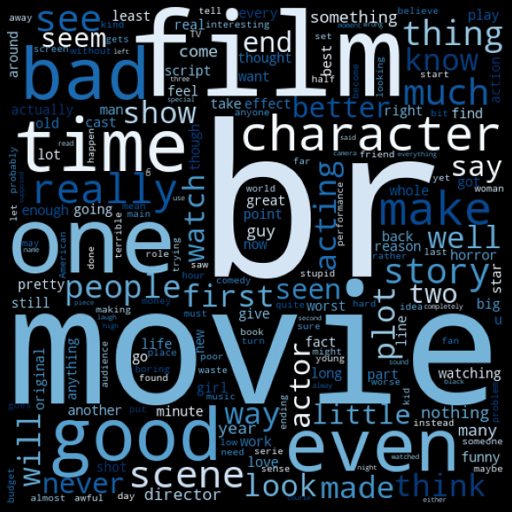
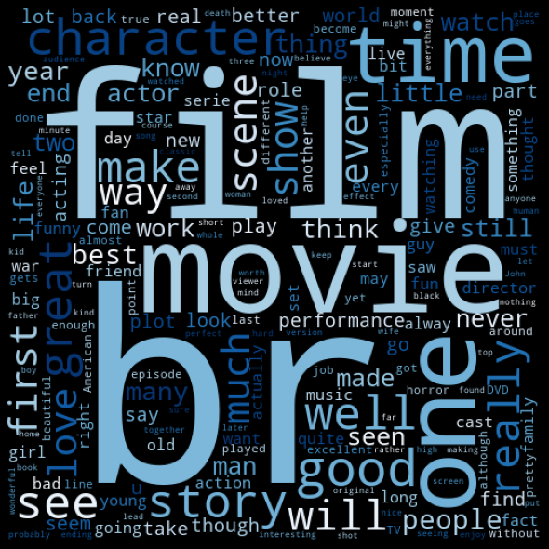
The binary classification of a movie review is:
positive, negative

Slide 6
Our process is easy
Explore
Data
Analysis
Cleaning Data
Train
ML &Deep Learning Models

Slide 7
2.
Explore The Data to gain insight

Slide 8
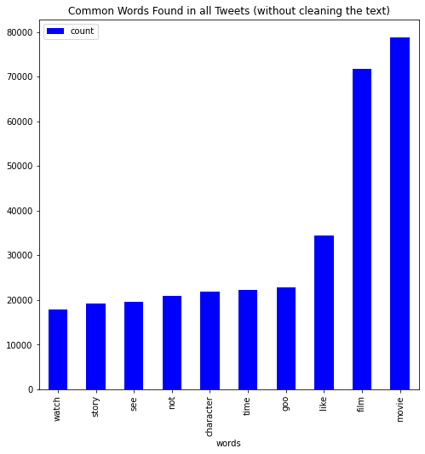
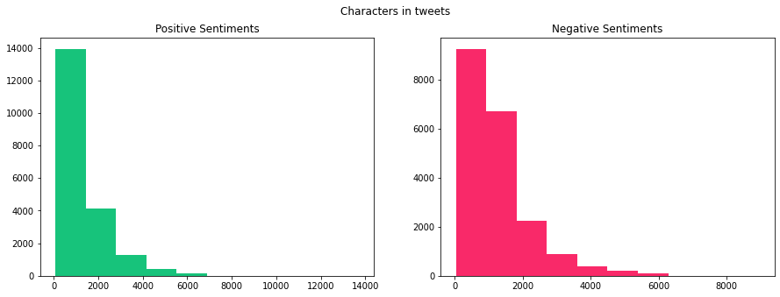
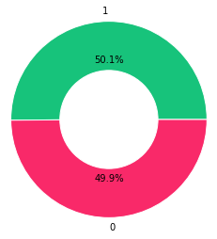
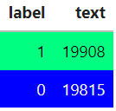
Explore Data Analysis

Slide 9
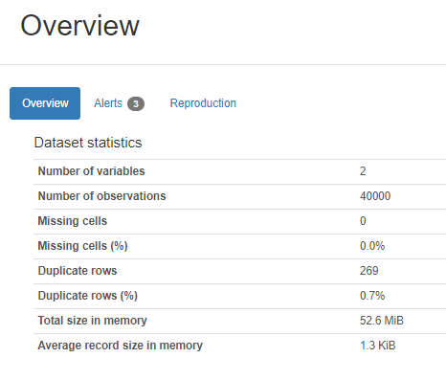
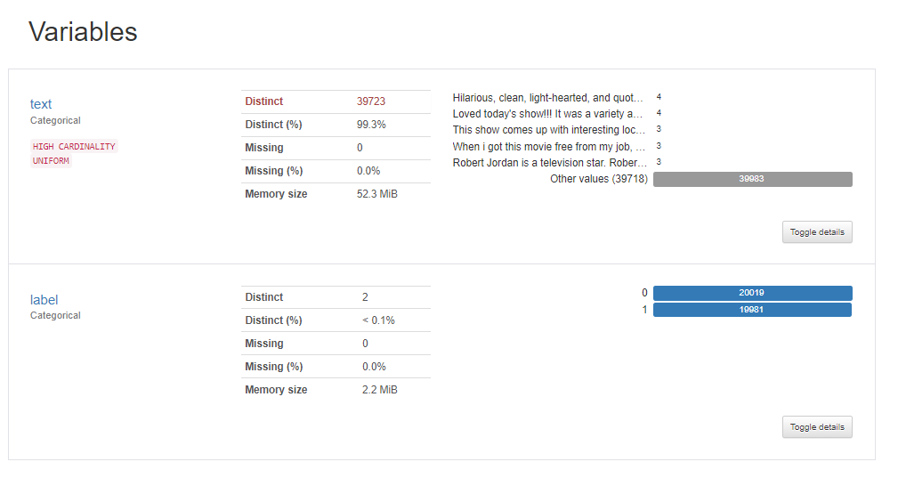

Slide 10
3.
Prepare the data

Slide 11
Steps of Cleaning & vectorization
Pre-Proceessing
Lemmatizing
Ngrams
CountVectorizer
TfidfVectorizer

Slide 12
Steps of Pre-processing
removing stopwords & punctuation
removing emoji & emoticons
removing mintions
removing html & urls
removing digits
removing single char & white spaces

Slide 13
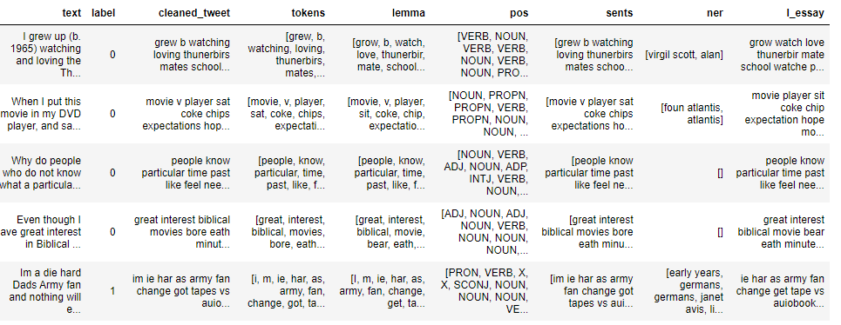
Steps of Pre-processing

Slide 14
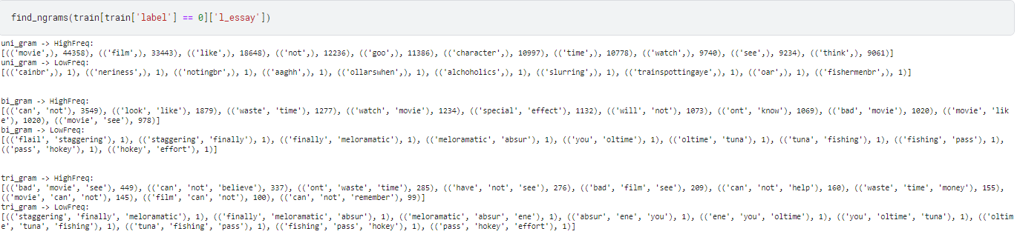
Ngrams

Slide 15
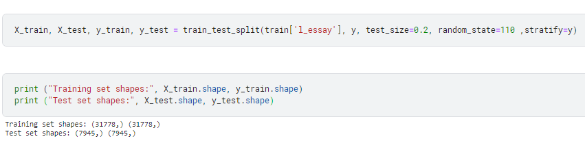
split the data

Slide 16
4.
Models for Texts Classification

Slide 17
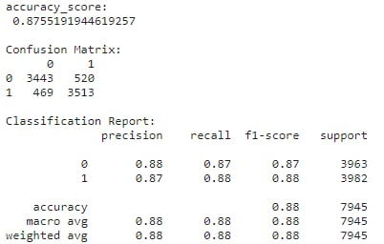
Naive bayes

Slide 18
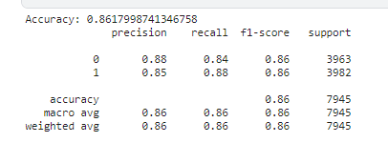
SGD

Slide 19
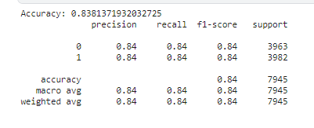
Random Forest Classifier

Slide 20
SVM

Slide 21
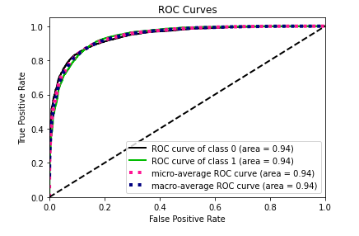
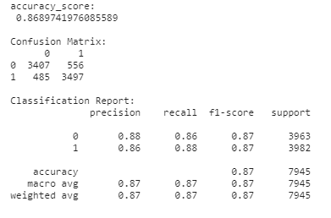
XGBoost

Slide 22
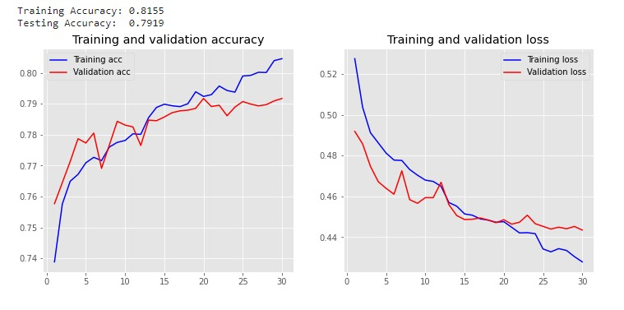
BERT (Bidirectional Encoder Representations from Transformers)

Slide 23
4.
Fine tune The model & Evaluation

Slide 24
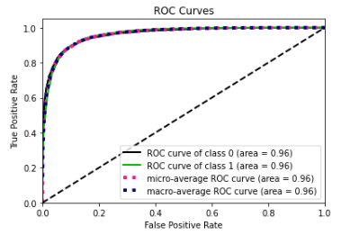
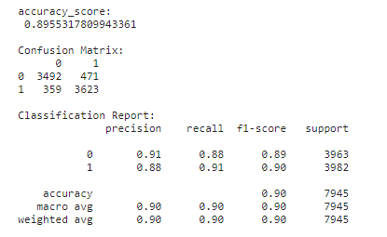
Logistic Regression

Slide 25
thanks!
Any questions?

